Slide 1
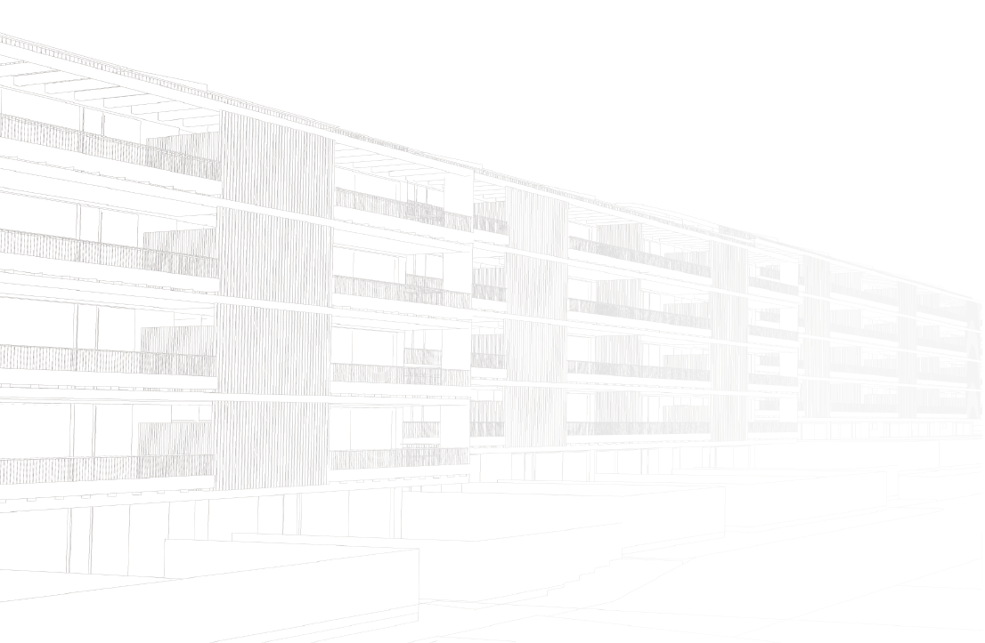
PROJECT INTRODUCTION
Plug-and-use renovation with adaptable lightweight systems.

Slide 2
ABOUT PLURAL
START: October 1, 2020
END: September 30, 2024
DURATION: 48 months
The European Research & Innovation project PLURAL funded by the Horizon 2020 programme aims to design, validate and demonstrate a palette of versatile, adaptable, scalable, off-site prefabricated Plug-and-Use kits.
The objectives of the project will be achieved through international cooperation of 18 partners from 7 European countries with overall budget of 9,5 million EUR.

Slide 3
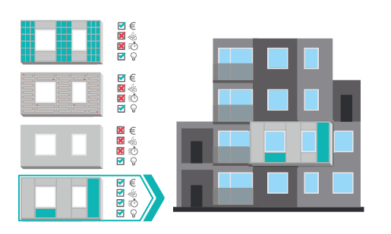
PLURAL CONCEPT
The key is to understand how to select and integrate various renewable energy technologies, incorporate them in prefabricated façade components and optimize their performance for different building types, climates and socio-economic conditions.
PLURAL will focus on how to manufacture these kits minimizing energy use and material waste.

Slide 4
PLURAL OBJECTIVES
PLURAL aims to design, validate and demonstrate a palette of versatile, adaptable, scalable, off-site prefabricated PnU kits. A Building Information Modelling (BIM) based platform and a Decision Support Tool (DST) will be developed to enable the optimal component selection, and integration, best PnU kit design, faster and low-cost manufacturing and installation. Renewable energy and smart control systems will be coupled with low environmental impact prefabricated façade components to create the integrated all-in-one PnU kits for residential building deep renovation.
Near zero energy consumption of buildings renovated with PnU kits
Cost-effective renovation
Fast-track renovation
Environmentally- friendlier deep renovation
Flexibility – Adaptability

Slide 5
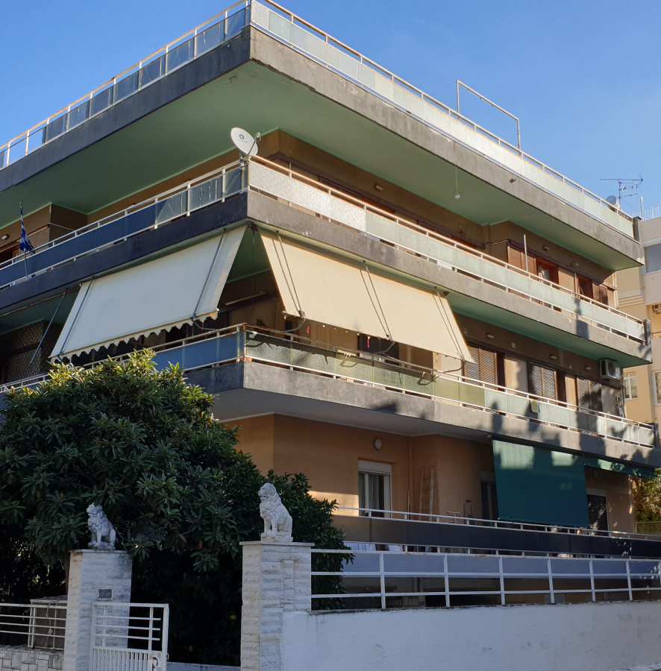
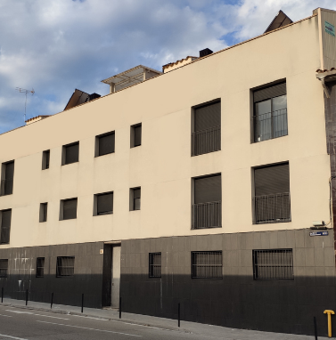
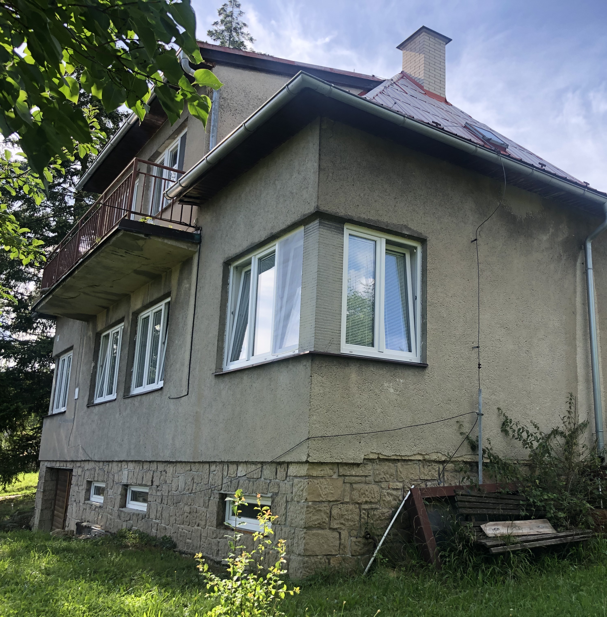
DEMONSTRATION SITES
The PLURAL concept will be integrated at three different real demo building sites, located in Greece, Spain and the Czech Republic, featuring different climate conditions, heating/cooling needs and user requirements.

Slide 6
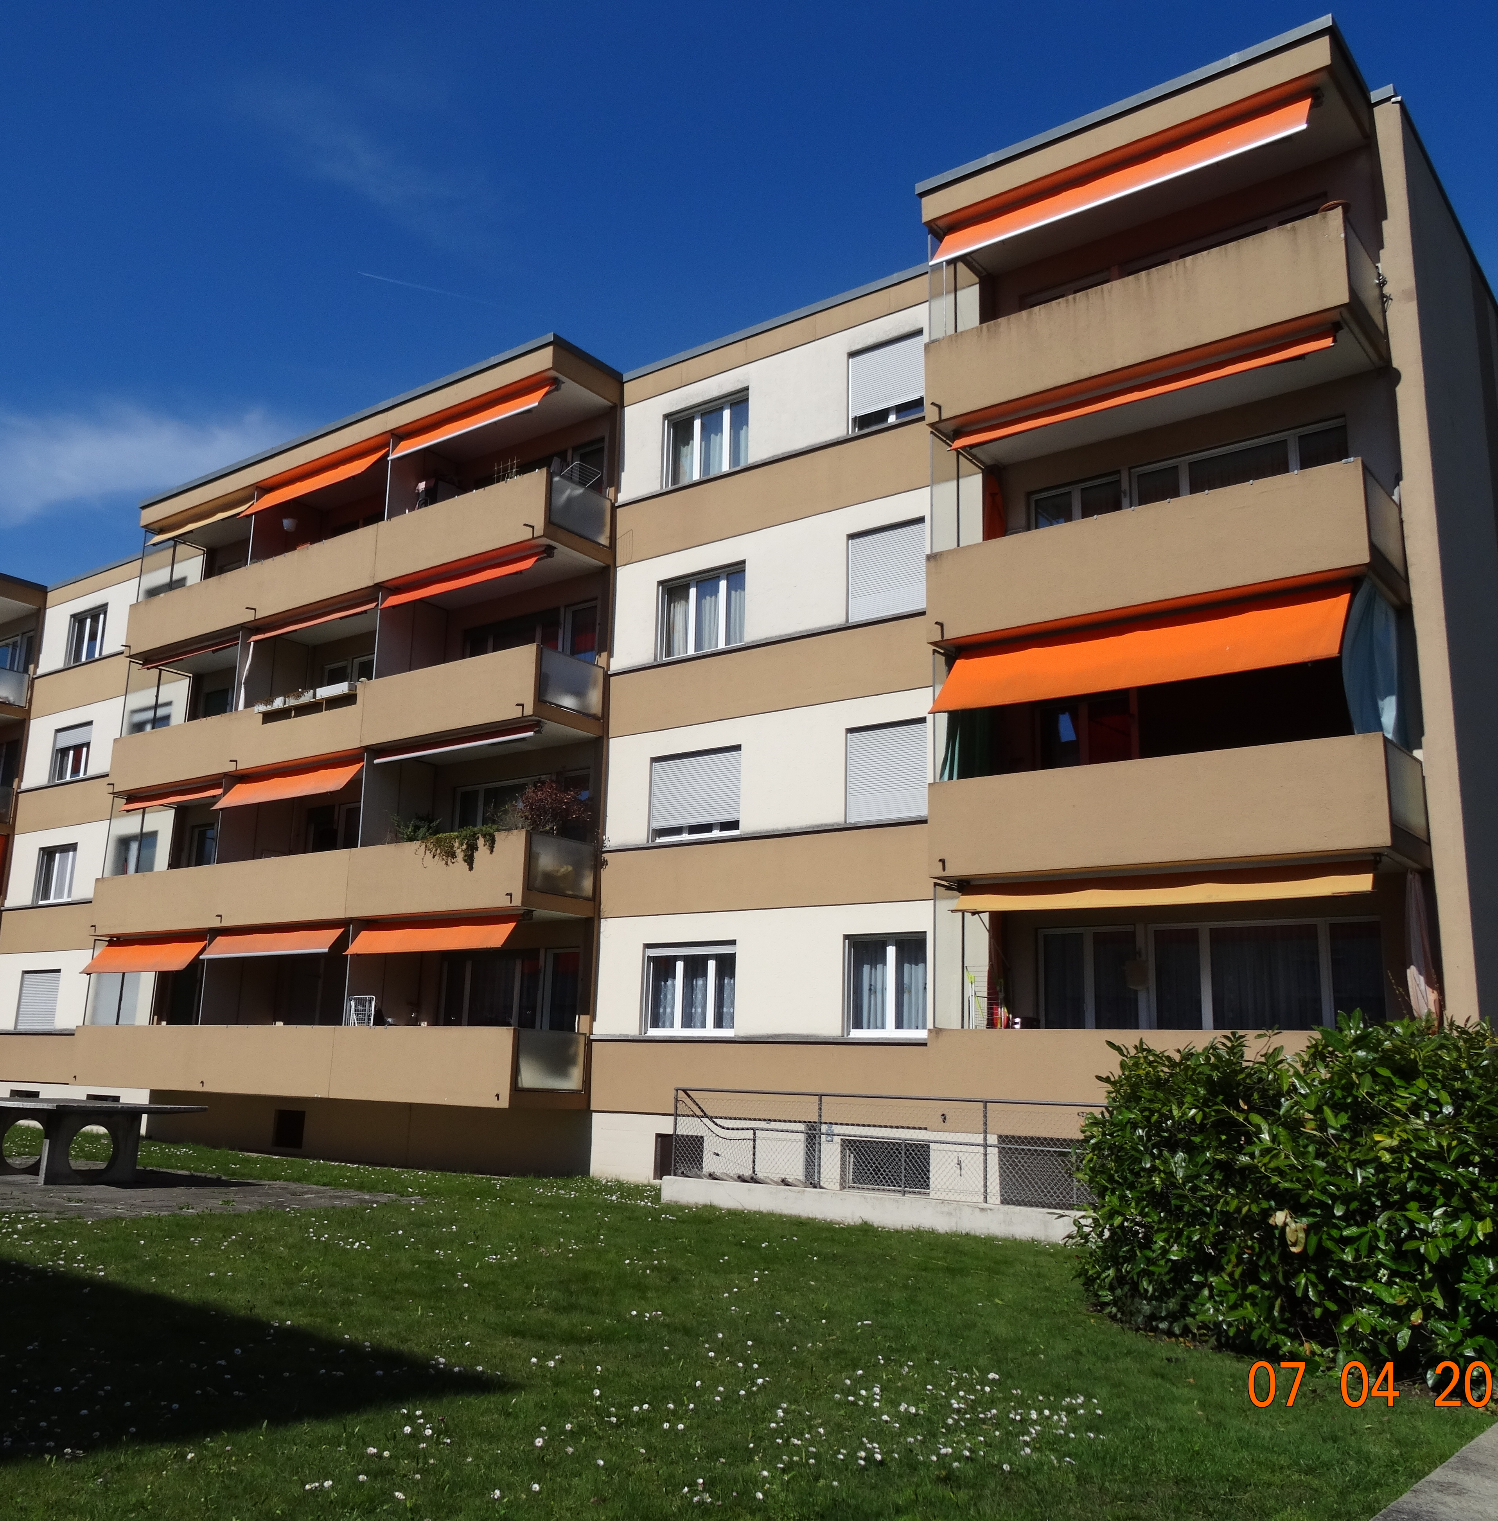
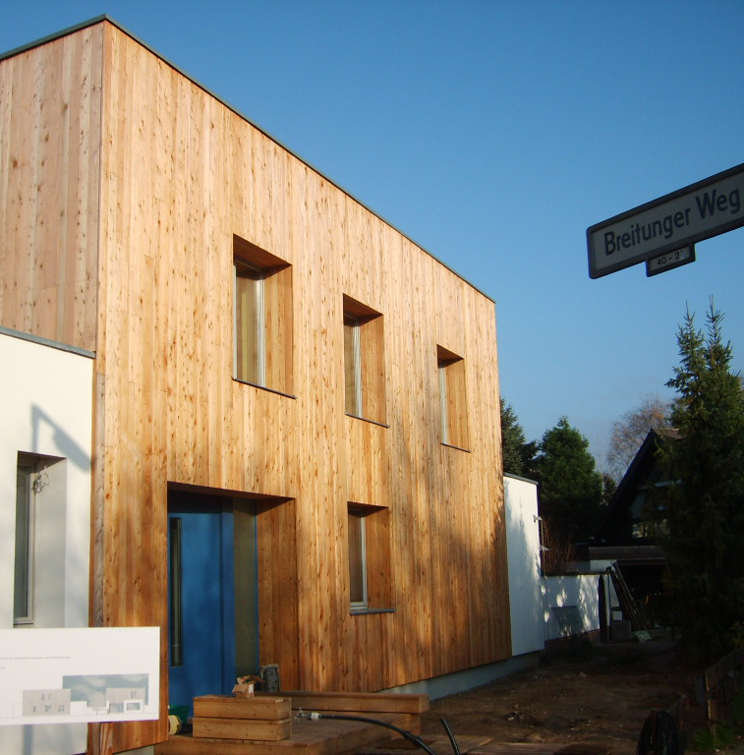
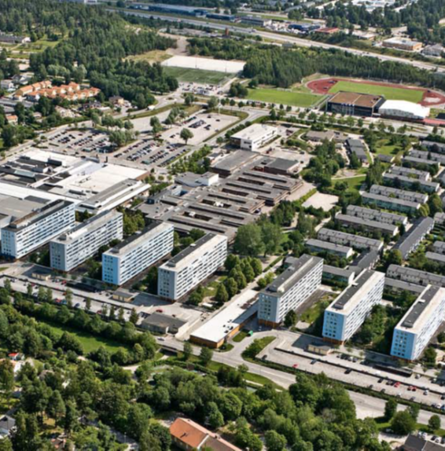
DEMONSTRATION SITES
PLURAL also includes three virtual building demos for simulating and validating the performance and operation of the solutions. The real demonstrators will also be used for their virtual assessment under conditions that differ from the actual ones. The virtual demos are located in Switzerland, Germany and Sweden.

Slide 7
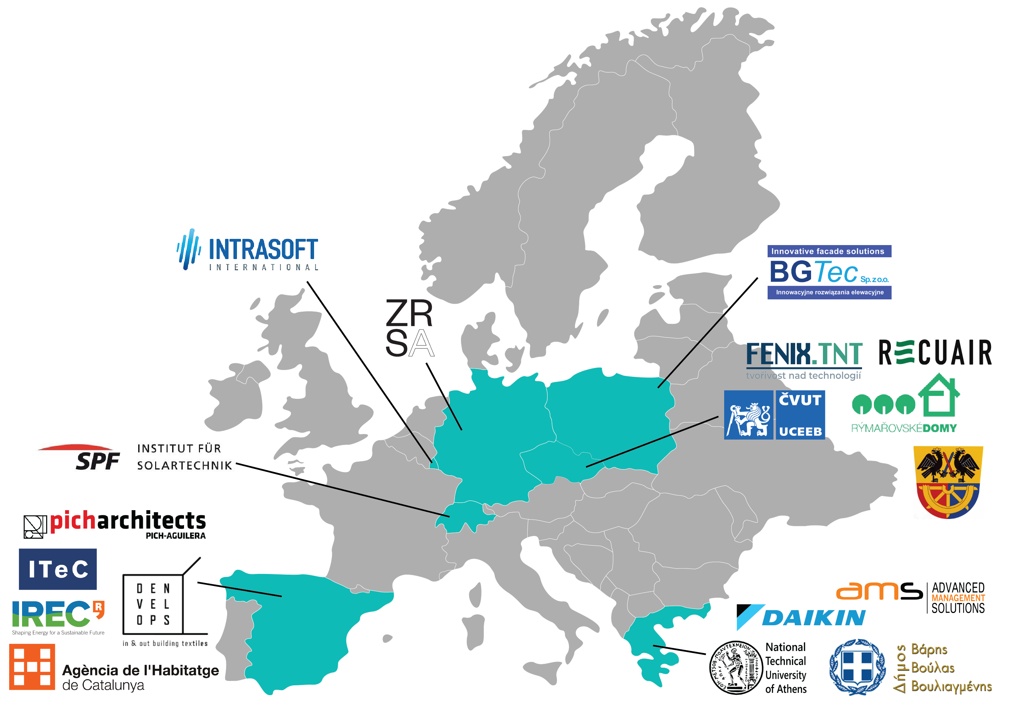
PARTNERS
Cooperation of 18 partners from 7 European countries.
Greece, Spain, Luxembourg, Switzerland, Germany, Poland and Czech Republic.

Slide 8
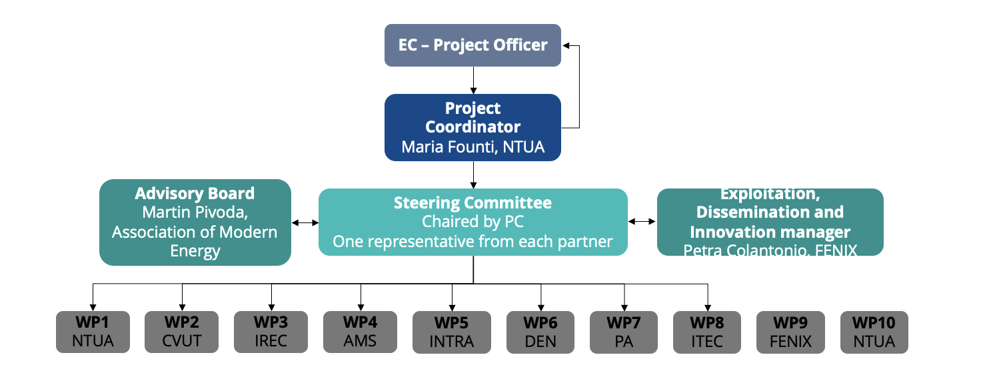
MANAGEMENT STRUCTURE

Slide 9
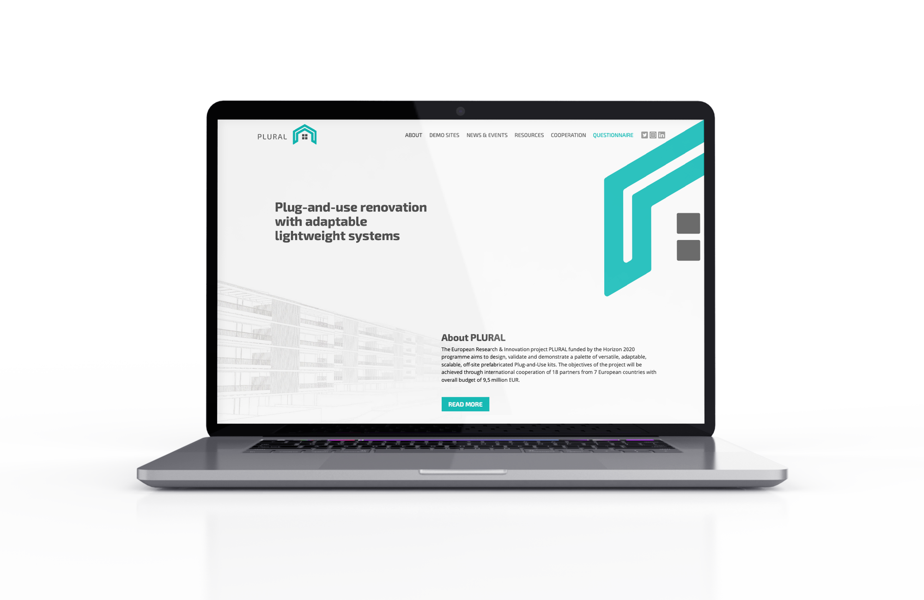
SOCIAL MEDIA
Follow the the PLURAL latest news on the project website and social media profiles.
@pluralproject_
@plural_renovation
@plural-renovation
PLURAL

Slide 10
Contact us via e-mail:
info@plural-renovation.eu
This project has received funding from the European Union’s Horizon 2020 research and innovation programme under grant agreement No 958218.
THANK YOU FOR YOUR ATTENTION!

